Slide 1
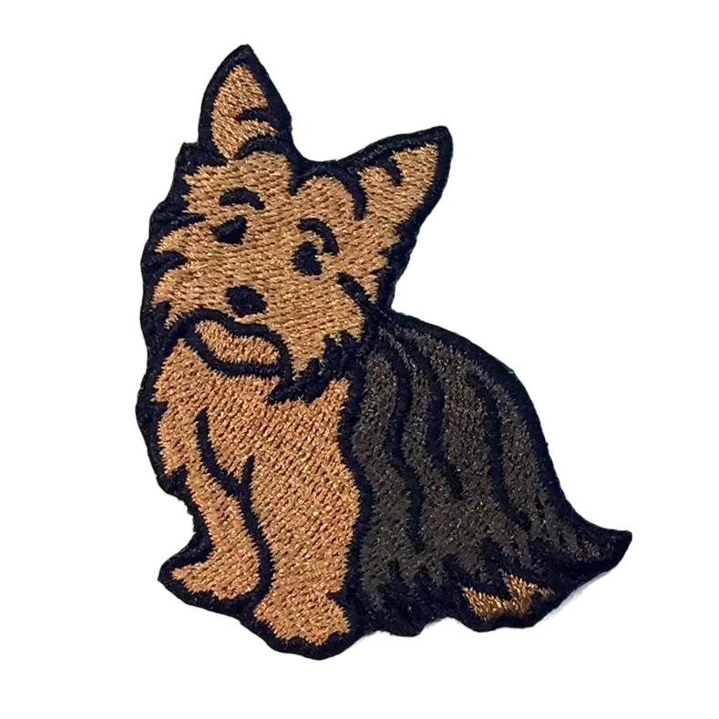
MTD Direct-To GoTo Proposal
LT Gordon “Yorkie” Kiesling
May 2024

Slide 2
Current Behavior
When AVPs command the UA to “GoTo” a lat/long pairing or named mission plan waypoint, the aircraft performs an erratic S-turn.
This behavior is unintuitive, and not in keeping with industry standards, specifically the behavior of the Flight Management Computer P-8A pilots are trained to use to navigate both through ICAO airspace and on-station.

Slide 3
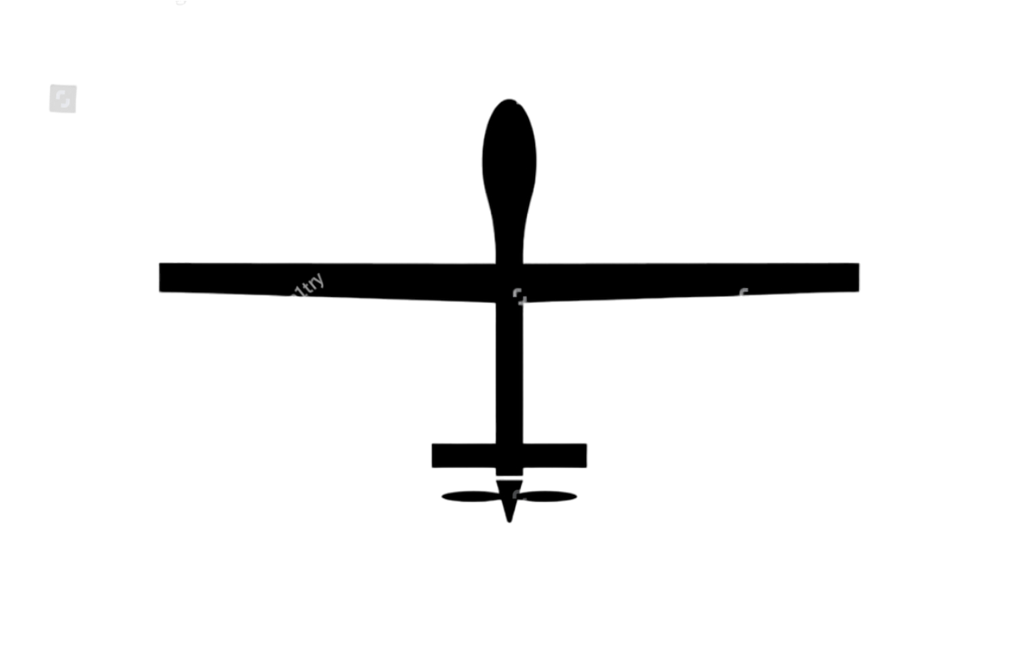
Current Behavior Visualization
Actual flightpath
P29
IMMC Calculation
Note: Northrop Grumman I am so sorry to use the MQ-9 here – It is all I could find on Google. Please don’t hold it against me.

Slide 4
Function Proposal
A direct-to function that will better emulate the navigation behavior all P-8A qualified pilots are used to.
This function would require no change to IMMC software – it would be entirely contained within the MTD. PENDING VERIFICATION
This function would issue a GoTo that would cause the UA to short-turn directly towards the desired waypoint.
Once the UA is facing the desired waypoint, a second, queued GoTo command would then execute to bring the UA direct to the waypoint the AVP specified.

Slide 5
Function Proposal (Continued)
AVPs currently do this manually as a matter of informal technique – but it requires the AVP to estimate when the UA is just about facing the desired waypoint in order to issue another GoTo command.
If an AVP is not paying close attention, or the MCS is experiencing high or intermittent latency, missing or mistiming the second command can result in an even more chaotic and unpredictable flight path for the UA, and possible airspace or standoff violations.
This function can automate the “double tap” method, and provide AVPs a tool for a more predictable flightpath.

Slide 6
Proposed Function Visualization
Intermediate Waypoint
P29
The UA now goes directly to the desired waypoint, with minimal time-in-turn and no S-turn

Slide 7

How would it work?
I’ve written a script in simulating a UA at on-station altitude over the Philippine Sea in Python 3.12, a free, powerful, and open-source programming language installed by default on all Windows operating systems.
This script exclusively uses built-in, standard system libraries to perform the calculations involved.

Slide 8
Simulation Parameters
Parameter | Low | High
TAS | 140 Knots | 300 Knots
Heading | 0° | 360°
Turn Rate | 1.3°/sec | 3.1°/sec
Wind Direction | 0° | 360°
Wind Speed | 25 Knots | 75 Knots
Latitude | 16.0°N | 16.5°N
Longitude | 133.0°E | 133.5°E
The script simulates several UA parameters, including:
True Airspeed
Heading
Turn Rate
Wind direction
Wind Speed
Position (lat, long)
Desired waypoint (lat, long)
These parameters are randomly selected, with floors and ceilings presented in the table to the right.
All of these parameters are static after the initial “pull” – in this script, they are determined once, at the instantaneous time of AVP command execution.

Slide 9
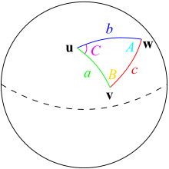
Under the Hood
Once the parameters have been generated, the script uses some basic geodesy calculations to find the “Intermediate Waypoint” the UA can fly to in order to achieve our desired behavior.
First, it calculates the great-circle course between the UA’s position at time of command execution and the AVP-specified “desired waypoint.”
Then, it applies a wind correction to find the crab angle the UA would instead fly. This helps give us a rough idea of what direction we’d like to turn.

Slide 10
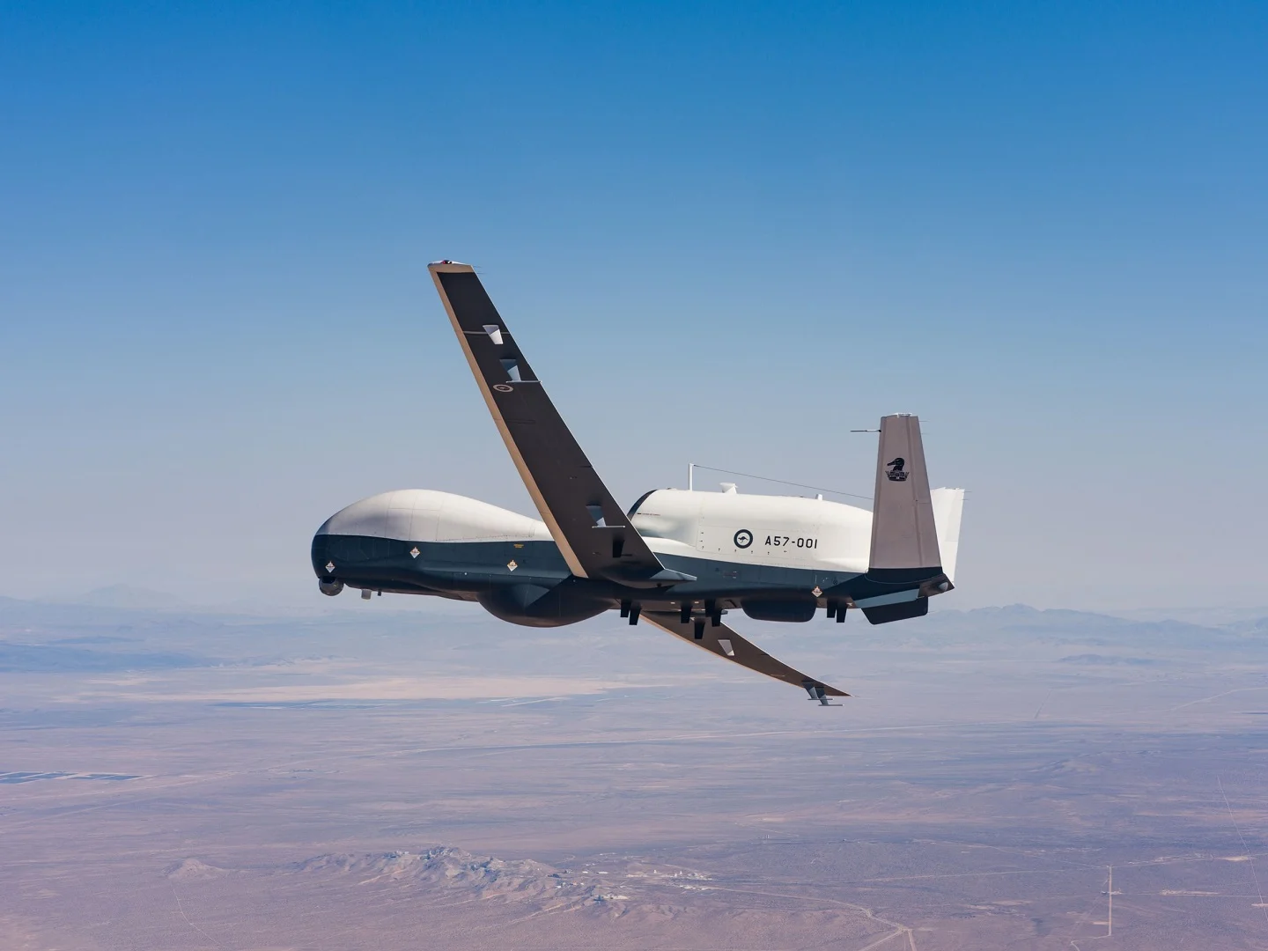
Under the Hood (Con’t)
Once that angle has been calculated, the program calculates the size of a left and right turn from UA current heading to the wind-corrected desired heading and determines which is smaller.
Choosing the smaller turn, the program estimates the time required to fly that turn based on the calculated turn rate.
Now the iteration starts. The program re-cages, assuming that the current position of the UA is (0, 0). A displacement in meters is calculated based on TAS and winds. This displacement is iterated every .01 seconds.

Slide 11
Under the Hood (Con’t)
Time | Latitude | Longitude | Heading
T+00 s | 16.450N | 133.460E | 165°
T+10 s | 16.442N | 133.465E | 150°
T+20 s | 16.438N | 133.475E | 135°
T+30 s | 16.437N | 133.488E | 120°
At each iteration, we calculate displacement from origin based on TAS, heading, and winds, and use that to determine the new lat/long of the UA. We also update the UA's heading and determine a new azimuth, or course, from its new position to the desired waypoint
This iteration continues until the difference between azimuth from UA position and current UA heading is <1°. The lat/long of the UA at that point is determined to be the “intermediate fix.”
Some simulated data is presented to the right. Examples of actual calculated solutions are presented in the next few slides, where we simulate an AVP using this function to fly directly to a simulated Mission Plan Waypoint P29.

Slide 12
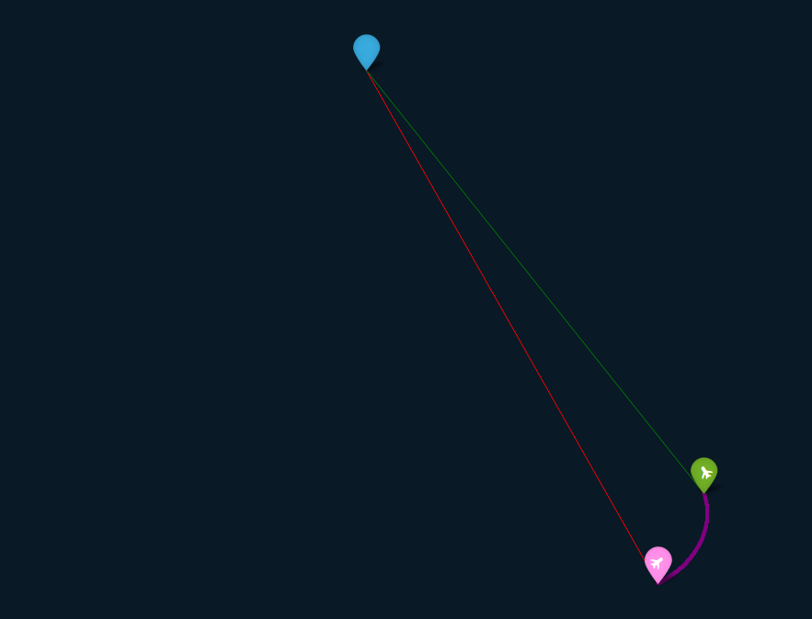
P29
The UA's current position is: | 16.09N, 133.43E
The desired waypoint position is: | 16.27N, 133.33E
Winds are currently: | 116 deg at 47 knots
TAS at start of turn: | 180 knots
Heading at start of turn: | 053 degrees TRUE
At it's current altitude, the UA will turn at: | 1.7 deg/sec
At start position, wind-corrected azimuth is: | 339 degrees TRUE
Right turn magnitude is: | 286 degrees
Left turn magnitude is: | 074 degrees
Shorter direction of turn is: | LEFT
The turn should take roughly: | 43.8 sec
At completion of turn:
Elapsed time: | 49.8 seconds
Elapsed iterations: | 4,981
UA lateral displacement is | 3.6 km
UA longitudinal displacement is | 1.9 km
UA heading at conclusion of turn is: | 329 degrees TRUE
intermediate waypoint is: | 16.1204N, 133.4521E
LEGEND:
Nominal Track (IMMC Calculated)
Start Position
Turn Flightpath
Intermediate Waypoint
Final Track
Wind Direction

Slide 13
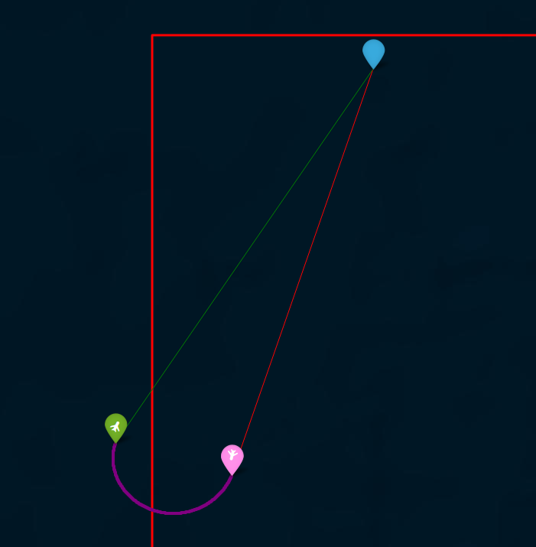
Long turn example:
P29
The UA's current position is: | 16.12N, 133.07E
The desired waypoint position is: | 16.47N, 133.2E
Winds are currently: | 262 deg at 43 knots
TAS at start of turn: | 300 knots
Heading at start of turn: | 194 degrees TRUE
At it's current altitude, the UA will turn at: | 1.9 deg/sec
At start position, wind-corrected azimuth is | 012 degrees TRUE
Right turn magnitude is: | 177 degrees
Left turn magnitude is: | 183 degrees
Shorter direction of turn is: | RIGHT
The turn should take roughly: | 95.7 sec
At completion of turn:
Elapsed time: | 104.2 seconds
Elapsed iterations: | 10,420
UA lateral displacement is | 3.1 km
UA longitudinal displacement is | -11.2 km
UA heading at conclusion of turn is: | 027 degrees TRUE
intermediate waypoint is: | 16.149N, 132.967E
LEGEND:
Nominal Track (IMMC Calculated)
Start Position
Turn Flightpath
Intermediate Waypoint
Final Track (no wind)
Wind Direction
NOTE: Red borders represent boundaries of randomly generated positions

Slide 14
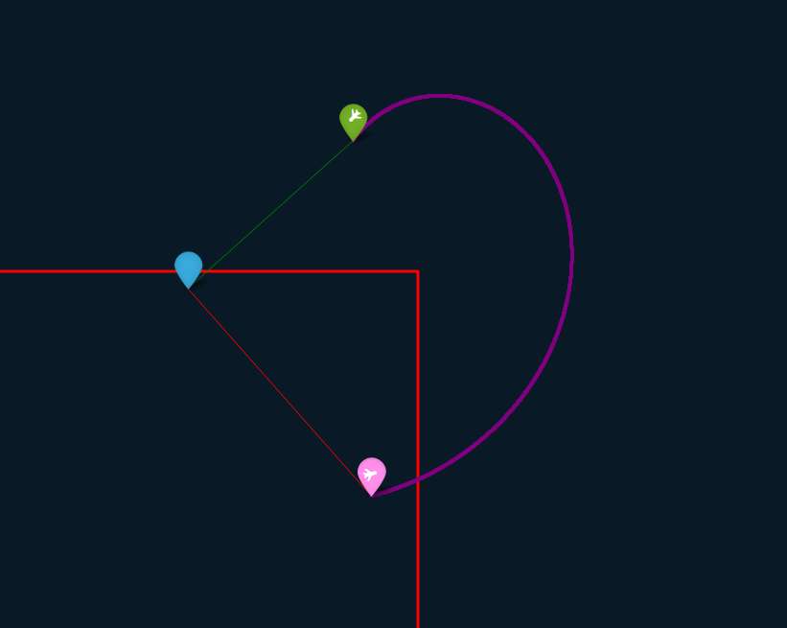
Short distance example:
The UA's current position is: | 16.06N, 133.09E
The desired waypoint position is: | 16.1N, 133.06E
Winds are currently: | 071 deg at 42 knots
TAS at start of turn: | 173 knots
Heading at start of turn: | 077 degrees TRUE
At it's current altitude, the UA will turn at: | 1.5 deg/sec
At start position, wind-corrected azimuth is: | 331 degrees TRUE
Right turn magnitude is: | 255 degrees
Left turn magnitude is: | 105 degrees
Shorter direction of turn is: | LEFT
The turn should take roughly: | 71.7 sec
At completion of turn:
Elapsed time: | 145.1 seconds
Elapsed iterations: | 14,510 (Wow!!)
UA lateral displacement is | 6.8 km
UA longitudinal displacement is | -0.4 km
UA heading at conclusion of turn is: | 224 degrees TRUE
intermediate waypoint is: | 16.1225N, 133.0883E
Wind Direction
P29
LEGEND:
Nominal Track (IMMC Calculated)
Start Position
Turn Flightpath
Intermediate Waypoint
Final Track (no wind)
NOTE: Red borders represent boundaries of
randomly generated positions

Slide 15
Constraints & Future Considerations
Turn-in, turn-out: The simulation does not account for intermediate bank angles as the UA enters and exits its turns. This is a minor source of error.
Changing air data: The simulation uses a “snapshot” of instantaneous air data at time of command execution. In reality, all pilots know that what your instruments show you over time, say, during a 145 second turn, bounces around., including TAS and winds.
Chapter 11 chart interpolation requirement: The MTD does not currently have access to expected instantaneous turn rate. This data can be calculated out of Chapter 11 of NATOPS, but remains an outstanding item on the to-do list.
Altitude lock: The MTD does not offer any way to send a Go To command with an altitude lock, with the result that “fly-by-MTD” is not a common AVP technique. This constraints this function in the terminal area while under an IFR clearance. I’m still thinking about this one… There may be a separate, long-term solution that would take the form of an entirely separate project.
Support for magnetic variation: All calculations so far have been performed in True, and I don’t know if the MTD is capable of pulling magnetic variation data from Linux. This is a problem that remains to be solved. Implementation, however, would be very simple, and because magnetic variation won’t vary significantly over the maximum of ~10nm this command could encapsulate, it can probably be ignored.

Slide 16

Future Capes
The MTD is written in C#, a programming language commonly used for building software applications, ranging from desktop applications to web services, developed by Microsoft.
This simulation is just that – a simulation, and a proof of concept. Significant changes to the code will be required both to translate it into C#, and to substitute real air and navigation data into the program vice what I have simulated.
There is much left to do – but I think there is a lot of potential here, and in the lessons learned from attempted implementation.

Slide 17
Fin
LT Gordon “Yorkie” Kiesling, VUP-19 (July 2024 check-in)
Gordon.s.kiesling.mil@us.navy.mil
+1-203-912-2652
For source code, please refer to my Github. The file is GoTo Direct.py.

